Slide 1
Gesture based Rover and Appliance Control
2017 Fall
Advanced Hardware Design
Team Presentation
Sigma Six
Group members:
Praveen Padala
Raj Shah
Manasa Tempalli
Zankhana Rana
Soumya Rama
Tauha Khan
Dec. 7, 2017

Slide 2
Outline
Introduction
Embedded Dev Board
Gesture Detection
Socket Connection
Rover and Appliance Control
Video Demo
Future Work and Applications

Slide 3
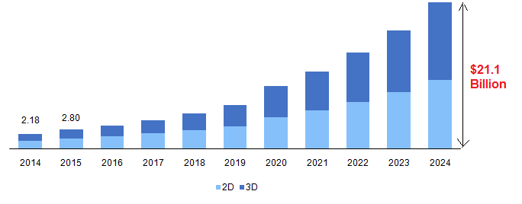
Why this Project?
1)Get Hands-on experience with this technology
2)Solve a real world problem-Use this to assist the Elderly
Global gesture recognition market revenue, 2014 – 2024 (USD Billion)

Slide 4
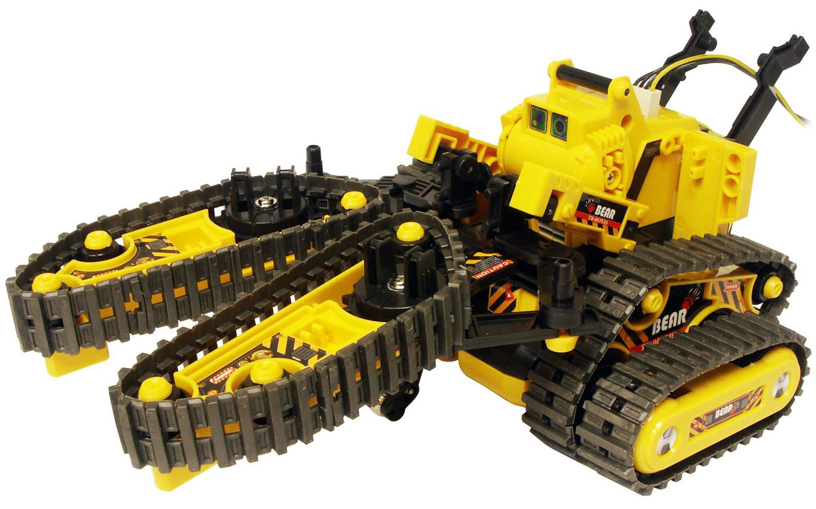

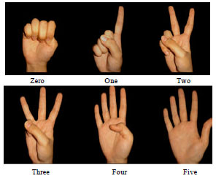



The Problem Statement

Slide 5
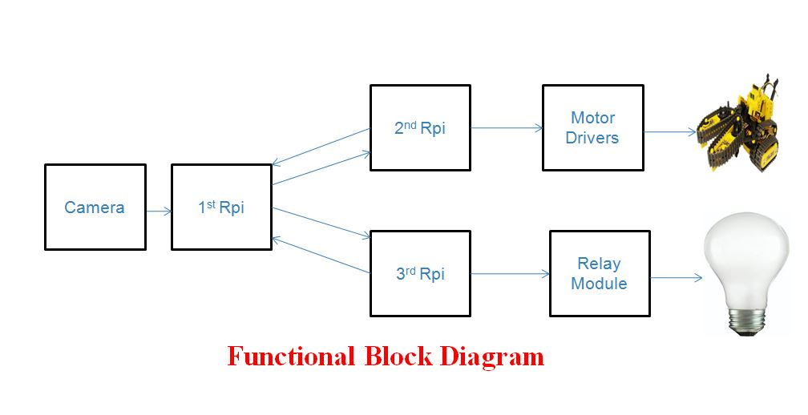
Implementation Details
Step-1:1st Rpi processes gestures using CNN and returns index value(0-9) of gesture with the maximum probability
Step-2:This index value is Multicast to the 2nd & 3rd Rpi’s connected to the rover and bulb
Step-3:The 2nd and 3rd Rpi’s execute predefined tasks based on the index number received
Step-4:Rover Rpi acknowledges 0-8 numbers, bulb Rpi acknowledges number 9
Step-5:Goto Step-1
Data transfer via Socket
Data transfer via Socket
Notes:
It assigns a probability value to the gesture and

Slide 6
Outline
Introduction
Embedded Dev Board
Gesture Detection
Socket Connection
Rover and Appliance Control
Video Demo
Future Work and Applications

Slide 7

Embedded Development Board
Development and prototype boards are computer boards that are used to develop or test electronic modules. These are used to evaluate programs for embedded devices such as controllers, point-of-sale (PoS) terminals, kiosks and information appliances.
Development boards combine a processor, chipset, memory and onboard peripherals with debugging features. Specifications for development boards include bus type, processor type, form factor, number of ports, port type, memory and operating system. In our implementation,Raspberrypi 3 model has been used.

Slide 8
Reason for choosing Rpi
Comparatively Cheap, Costs around $40
Has ‘Raspbian’ OS running on it. The numerous advantages of having an OS are ease of implementation-Programmer Friendly
Abstraction (The user doesn’t have to know all the low level implementation details like: Register manipulation etc.,)
Well suited for Image Processing
This development board features a SoC, with an integrated ARM, compatible CPU and on Chip GPU
It has on board Wifi , Bluetooth and USB boot capabilities making it very useful for wireless communication purposes.
It is compatible with multiple operating systems such as Linux, Windows, IOT Core, RISC OS

Slide 9
Outline
Introduction
Embedded Dev Board
Gesture Detection
Socket Connection
Rover and Appliance Control
Video Demo
Future Work and Applications

Slide 10
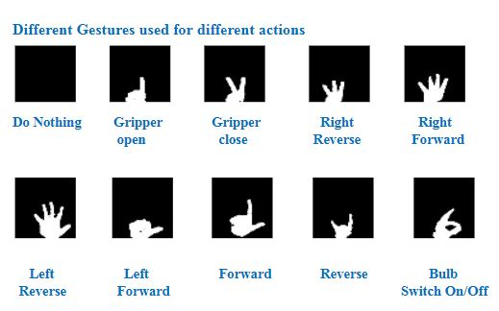
How Hand Gesture Works
Notes:
Traditional Methods using computer vision not very efficient and complex.

Slide 11
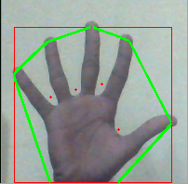
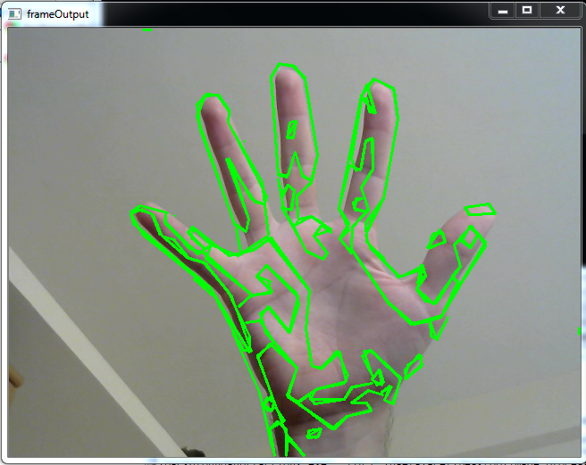
Problems with Other Methods
Notes:
Traditional Methods using computer vision not very efficient and complex.

Slide 12

Neural Networks
Notes:
Basic Idea of neural network is analogous to the neurons in our brain.
Input Layer ,Hidden Layers and Output Layer.
The lines correspond to weights and bias.

Slide 13
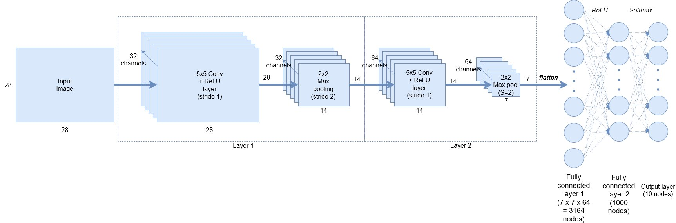
Convolutional Neural Networks
Architecture
Notes:
It’s a branch of artificial Neural Networks which is specifically used for image processing applications.
Convolutional Neural network is state of the art technique which tries to work in a similar fashion as human vision.

Slide 14
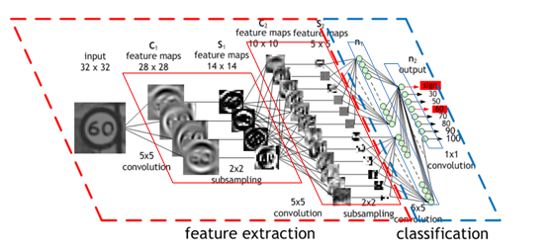
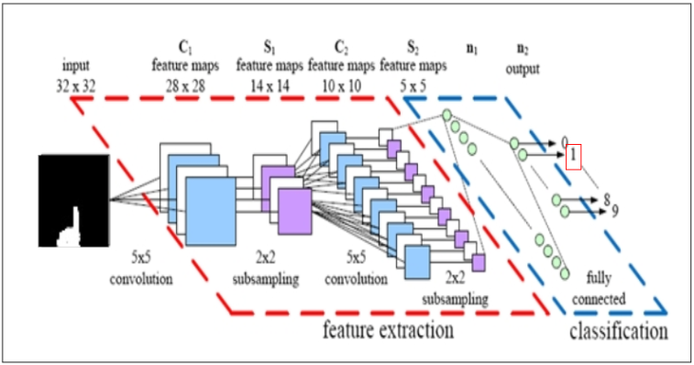

Convolutional Neural Networks
Notes:
Feature maps learns about different features of the image by using convolution max pooling.
Two Fully connected layer. Softmax function to get probabilities. Supervised Learning - meaning we know target variable beforehand.
Two parts- Training and testing

Slide 15
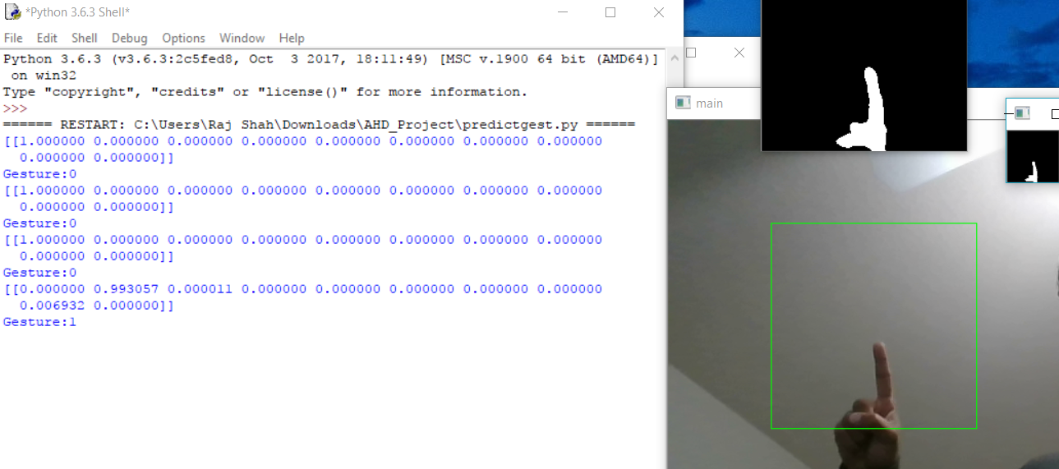
Implementation
Notes:
The webcam captures the frames and once it has received a certain threshold of frames sequentially only then it approves the gesture.

Slide 16
Outline
Introduction
Embedded Dev Board
Gesture Detection
Socket Connection
Rover and Appliance Control
Video Demo
Future Work and Applications

Slide 17
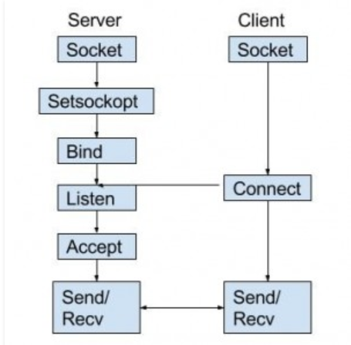
Socket Programming
Way of connecting two
nodes on a network
One socket(node) listens on
a particular port at an IP
Other socket reaches out to
form connection
Server forms the listener
socket while client reaches
out to the server
Notes:
-Socket programming is a way of connecting two nodes on a network to communicate with each other.
-One socket(node) listens on a particular port at an IP, while other socket reaches out to the other to form a connection.
- Server forms the listener socket while client reaches out to the server.

Slide 18
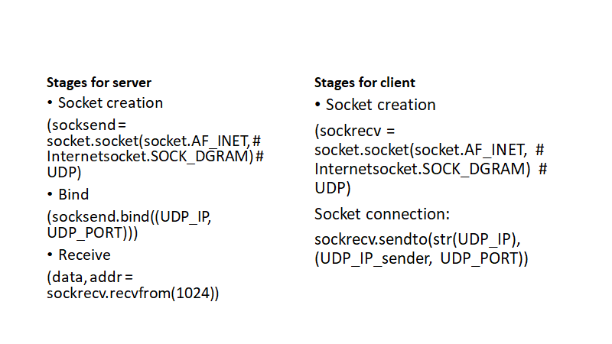
How Network connection is established

Slide 19
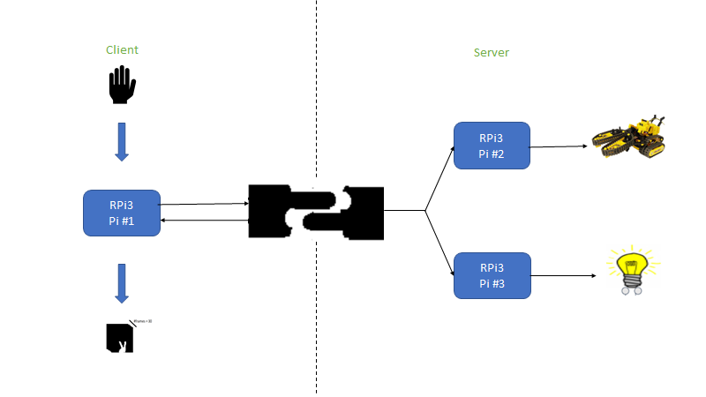
Socket connection implementation

Slide 20
Outline
Introduction
Embedded Dev Board
Gesture Detection
Socket Connection
Rover and Appliance Control
Video Demo
Future Work and Applications

Slide 21
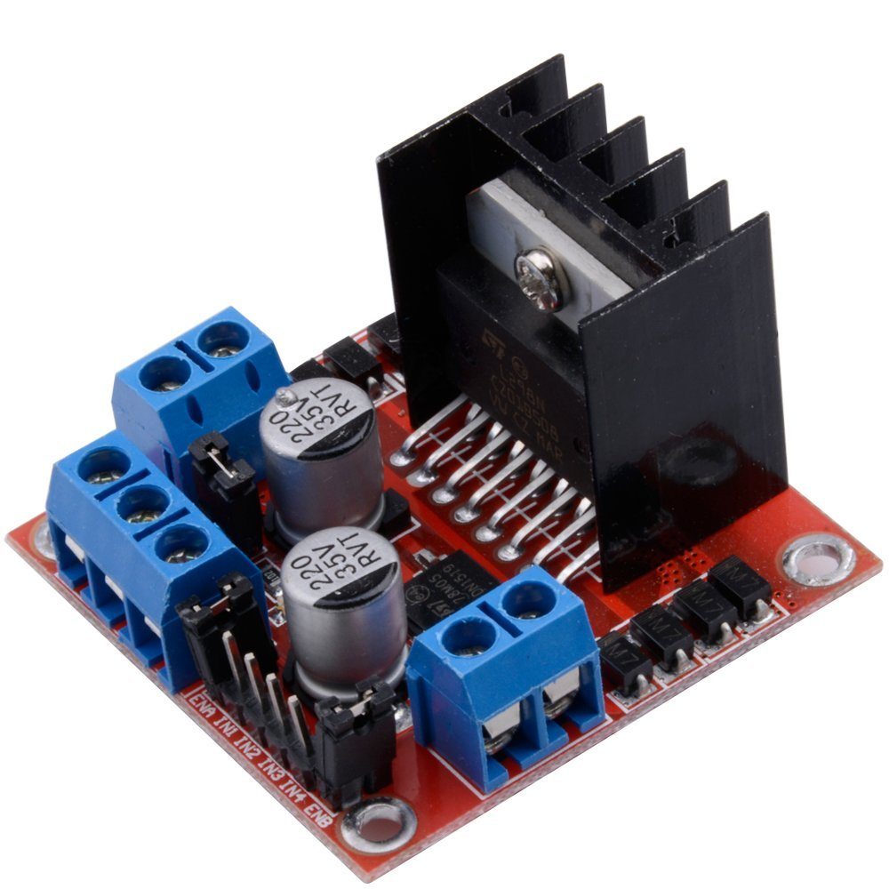
Working Of Rover With Gripper
The rover with gripper module consist of 3 DC motors that help it traverse along the ground and lift objects using the gripper.
Motors M1 and M2, based on the input signals, allows the rover to move left, right, and back and forth.
Motor M3, based on the input signal, opens and closes the gripper.
An L298 Motor drive controller is used to control the motors. The driver ties in the input signals from RPI3.
The motor drive module controls the speed and direction of the motors.

Slide 22
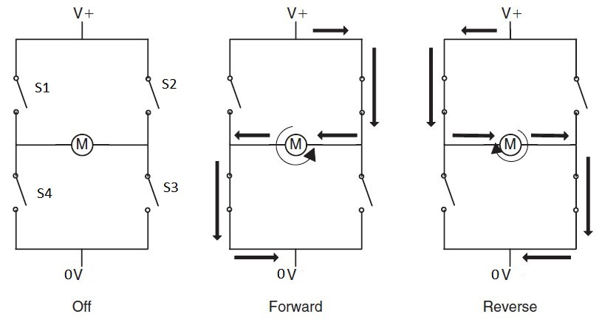
Motor Driver Module (L298 Dual H-Bridge)
The L298N is a dual H-Bridge motor driver which allows speed and direction control of two DC motors at the same time.
Enable | Input 1 | Input 2 | Motor Direction
1 | 1 (S2,S4=close) | 0 (S3,S4=open) | Forward Rotation
1 | 0 (S2,S4=open) | 1 (S3,S4=close) | Reverse Rotation
1 | 0 (S3,S4=open) | 0 (S3,S4=open) | Standstill
0 | X | X | Standstill

Slide 23
Rover With Gripper Control Actions
Following is the table that shows the gesture commands and the corresponding control actions for motor, and the output that follows:
Gesture signal | Motor 1 (Gripper) | Motor 2 (Left) | Motor 3(Right) | Output action
Gesture 1 | Open | 0ff | Off | Gripper open
Gesture 2 | Close | Off | Off | Gripper close
Gesture 3 | Off | Rev | Off | Left reverse
Gesture 4 | Off | Fwd | Off | Left forward
Gesture 5 | Off | Off | Rev | Right Reverse
Gesture 6 | Off | Off | Fwd | Right forward
Gesture 7 | Off | Fwd | Fwd | Both forward
Gesture 8 | Off | Rev | Rev | Both reverse

Slide 24

Controlling an Appliance (Light Bulb)
The control signal for turning on/off the light bulb comes from the RPI3 GPIO pin. This signal is based on a hand gesture ‘9’.
The bulb needs 120V supply to turn on. We use a 5V DC mechanical relay which takes the input signal at Pin ‘IN’ of relay module. Based on this input signal the bulb will turn on or off.
The phase terminal of the AC source is connected to the ‘COM’ pin. The neutral terminal of AC source is connected to negative terminal the light bulb.
In our case we use NO (normally open) contact to connect to phase terminal of the light bulb.
When the ‘IN’ signal is high, the NO contact closes, providing 120V supply to bulb, thus completing the circuit and turning on the bulb.
RPI3
GPIO
GND
5V
Relay Module
Vcc
IN
GND
COM
NO
NC
AC Source
+
-

Slide 25
Outline
Introduction
Embedded Dev Board
Gesture Detection
Socket Connection
Rover and Appliance Control
Video Demo
Future Work and Applications

Slide 26
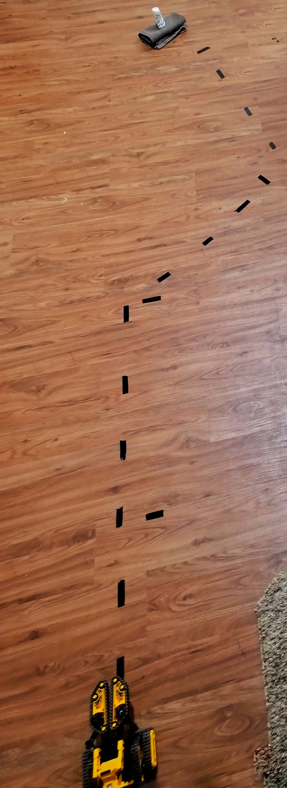
Path followed by the bot
OBJECT
PATH
ROBOT

Slide 27
Refreshing the Hand Gesture
Notes:
Traditional Methods using computer vision not very efficient and complex.

Slide 28
Video Demo
https://www.youtube.com/watch?v=KWB5O_lDwE8

Slide 29
Outline
Introduction
Embedded Dev Board
Gesture Detection
Socket Connection
Rover and Appliance Control
Video Demo
Future Work and Applications

Slide 30
Future Work
Have More Gestures to perform more number of tasks
Incorporate a Camera Module on the Rover and also implement obstacle avoidance
Have positional feedback on motors for better controllability

Slide 31
The Big Picture
Gesture-based surgical manipulation
Hand Gesture Based Wireless Robotic Arm Control for Agricultural Applications

Slide 32
References
Gesture Recognition Market Analysis By Technology (2D, 3D), By Application (Tablets & Notebooks, Smartphones, Gaming Consoles, Smart Televisions, Laptops & Desktops) And Segment Forecasts, 2014 - 2024
http://cs231n.github.io/convolutional-networks/
https://cs.nju.edu.cn/wujx/paper/CNN.pdf
https://github.com/Hvass-Labs/TensorFlow-Tutorials

Slide 33
Questions?

